Slide 1


Course: Guided Research Project Title: Evaluating Performance Scalability of Microservice-Based Application
COMPUTER SCIENCE AND DATA ANALYTICS
Student: Tural Mehtiyev
Instructors & Supervisors: Dr. Stephen Kaisler, Dr. Jamal Hasanov
Date: 08.08.2023

Slide 2

Why this topic?/ Why now?
Problem: “Scalability issues causing performance issues and as a result substantial financial losses highlight the critical need for rigorous performance testing in today’s software applications”
Performance Impact
Profitability Impact
User Expectations
Software performance and scalability issues lead to poor user experiences and customer loss.
As per a report by the Information Systems Audit and Control Association (ISACA), poor performance directly impacts operational efficiency, customer satisfaction, and ultimately profitability
A Microsoft study found that 33% of users would abandon a website that's prone to crashing or slow speeds, highlighting the importance of stability and performance for retaining users.
A survey
by ITIC found that
An IDC
study suggests that
A study by
Gartner estimates
According
to a study by Akamai
Amazon found that
86% of companies a single hour of downtime would cause a significant reputational impact.
scalability issues cost businesses
an average of $10,000 - $100,000 per hour
Average cost of
downtime
$5,600 per minute
40% of consumers abandon a website that takes more than 3 seconds to load.
100ms increase in page load time led to a 1% decrease in sales
Server Downtime
High Traffic Events
Amazon's website went down for just 40 minutes in 2018, and the estimated cost to the company was approximately $4.6 million in lost sales.
In 2015, Target's website crashed on Cyber Monday, a critical online shopping day, causing a significant loss of potential revenue and customer trust.

Slide 3
Project Objective
“The primary objective of this project was to gain fundamental insights into software scalability challenges, laying a groundwork for further exploration and potential solutions in handling modern application performance issues in my master thesis and later doctoral studies."
System Design & Architecture
Microservice Implementation
Functionality Testing
Software Application Deployment
Developing Expertise in tech stacks
Documentation Methodologies
Data Cleaning and Pre-processing Techniques
Data Visualizations
Statistical Applications
Interpretations & Insight Driving
Topic Investigation
Application Development
Performance Testing
Analysis Methodology
Study of Performance Scalability Issues
Understanding Microservice Architecture
Factors Impacting Scalability
Current Challenges
Key Metrics Comprehension
Tool Mastery (Apache JMeter)
Test Scenario Design and User Behavior Simulation
Experimental Data Gathering
Grasping the fundamental load testing Limitations

Slide 4
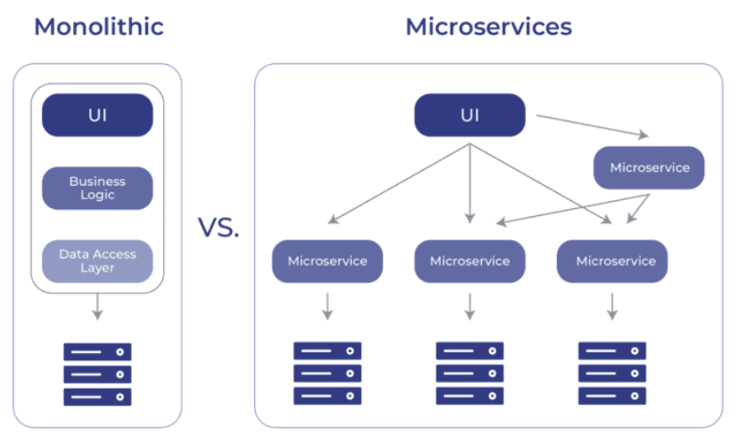
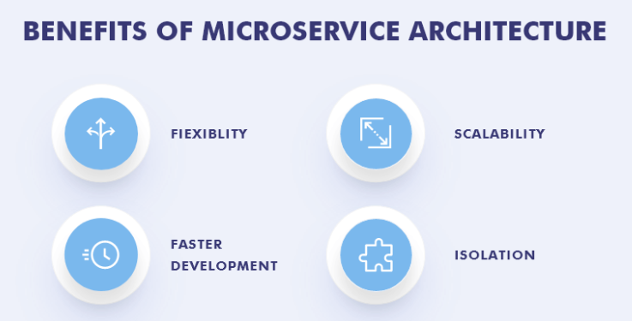
How Is It Done Today
Today's monolithic architectures are limited in scalability due to their tightly integrated components, whereas microservices address this challenge by enabling granular and independent scaling of discrete services.

Slide 5
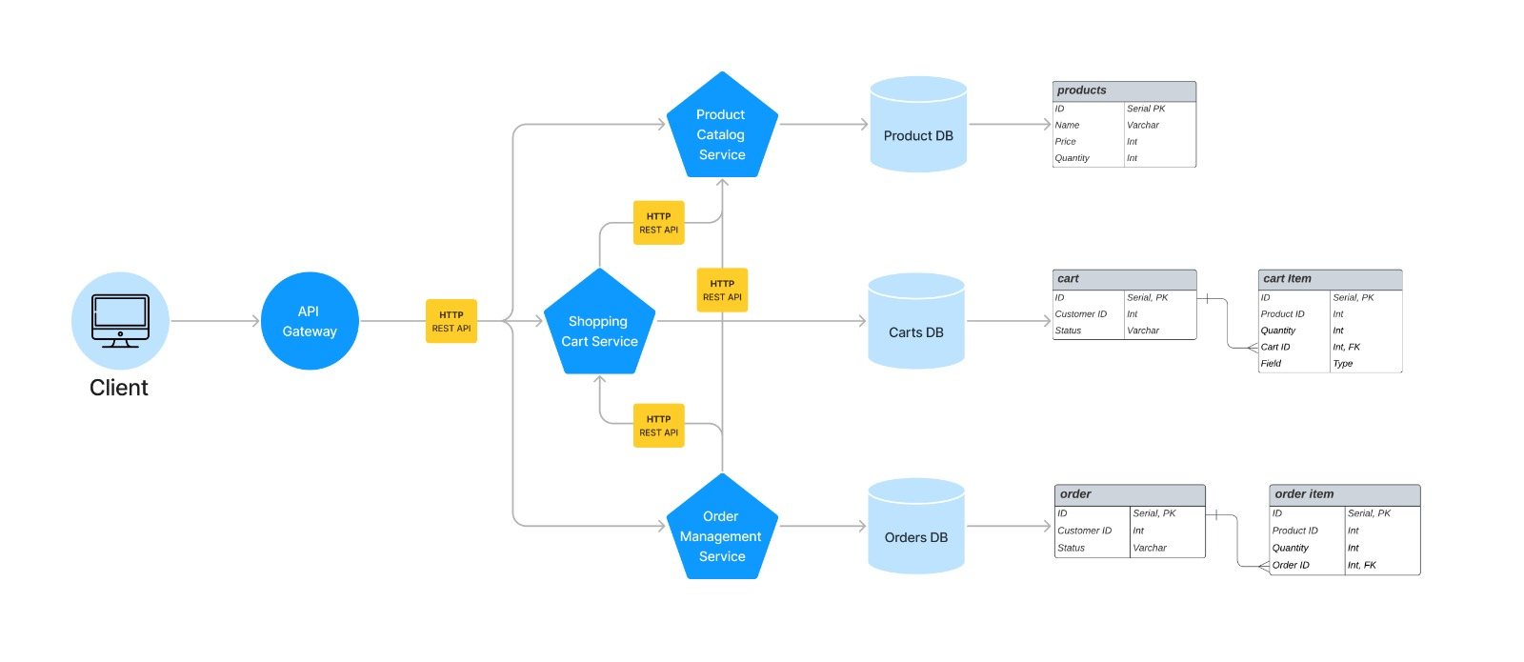
Technical Approach: Architecture Diagram

Slide 6
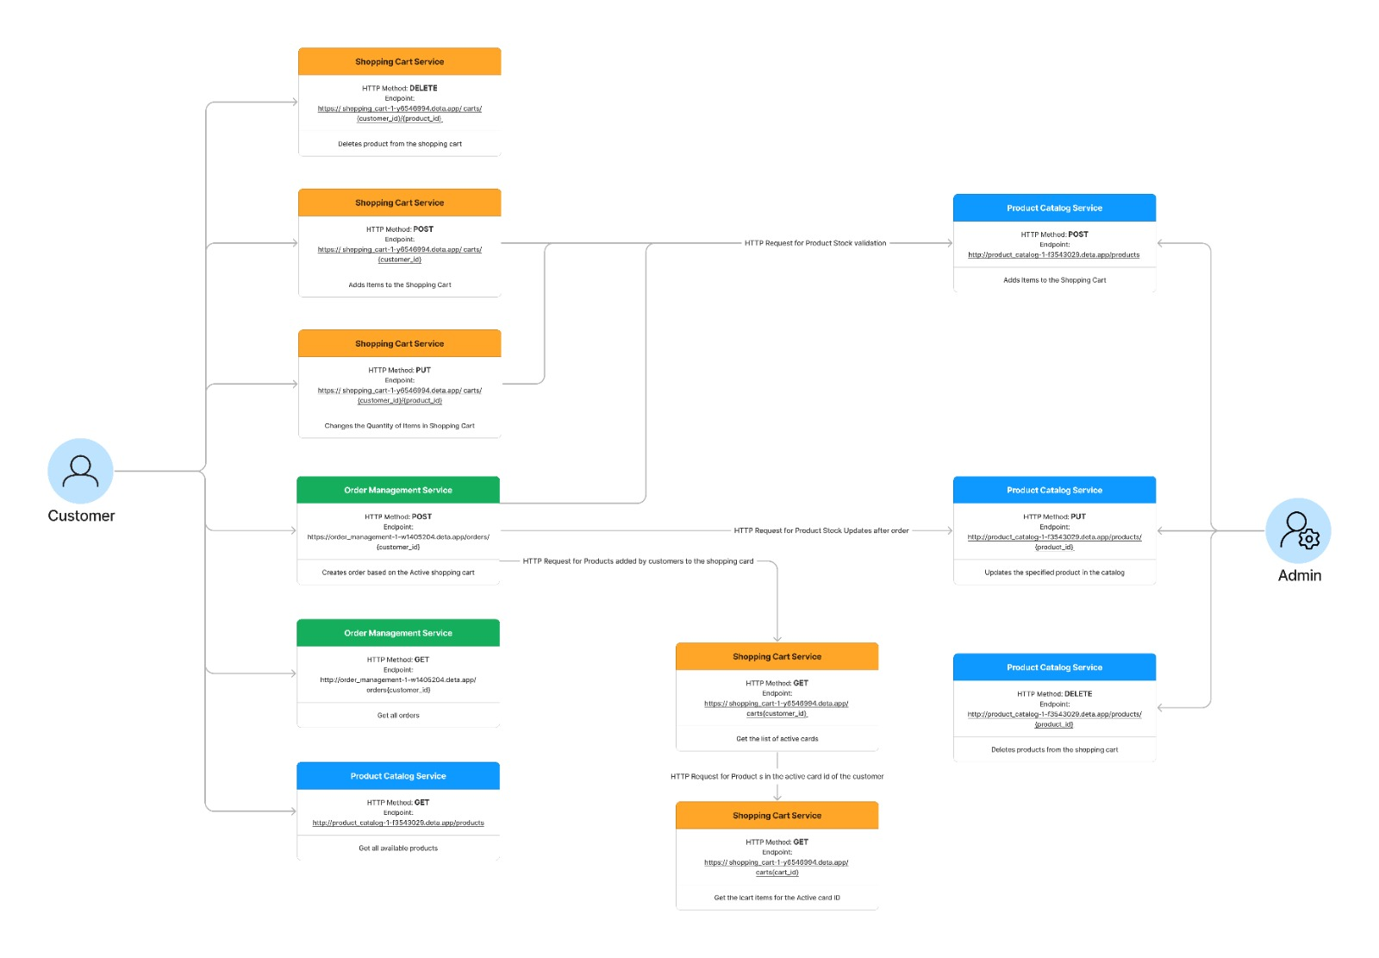
Technical Approach: Use Case Diagram

Slide 7
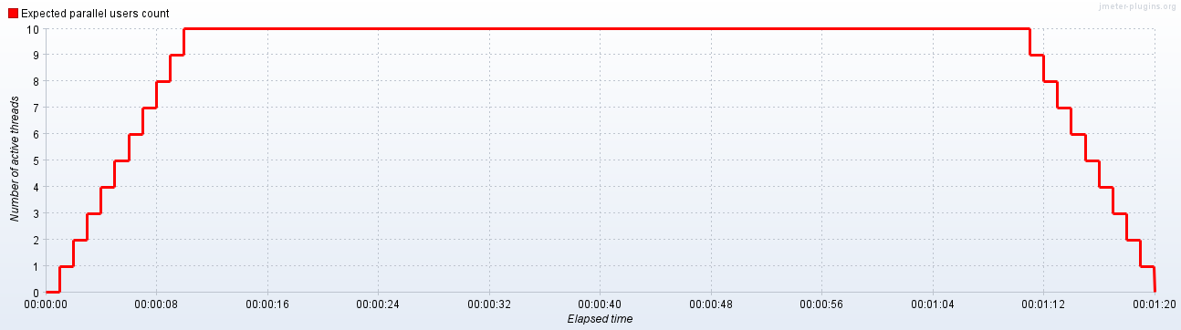
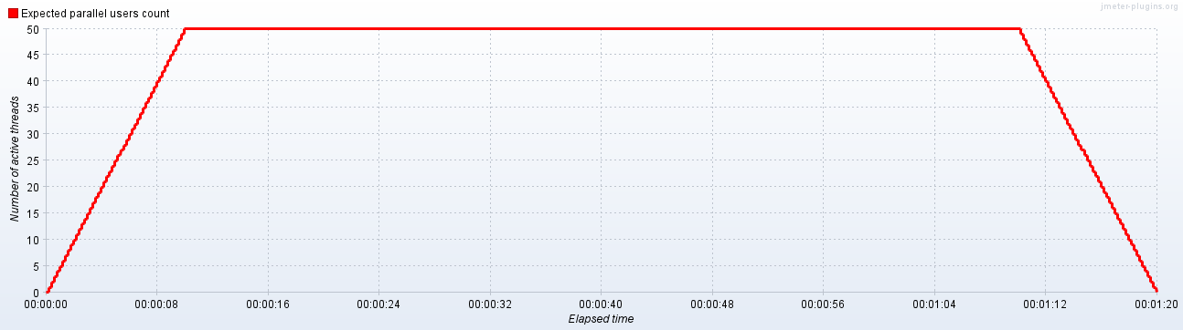
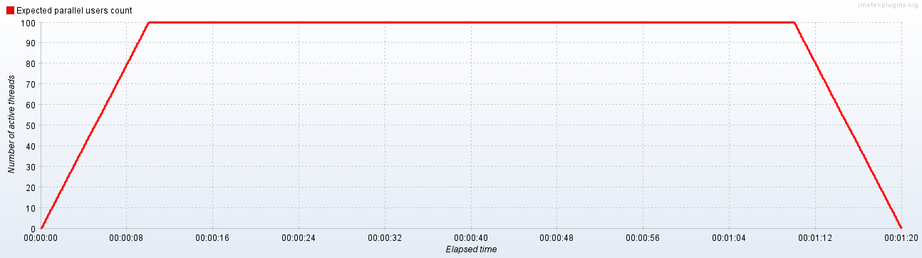
Technical Approach: Load Test Scenarios
Metrics | Value
Start Threads Count | 10
Initial Delay, sec | 0
Startup Time, sec | 10
Hold Load For, sec | 60
Shutdown Time, sec | 10
Load Test Scenario 1
Metrics | Value
Start Threads Count | 50
Initial Delay, sec | 0
Startup Time, sec | 10
Hold Load For, sec | 60
Shutdown Time, sec | 10
Load Test Scenario 2
Metrics | Value
Start Threads Count | 100
Initial Delay, sec | 0
Startup Time, sec | 10
Hold Load For, sec | 60
Shutdown Time, sec | 10
Load Test Scenario 3

Slide 8
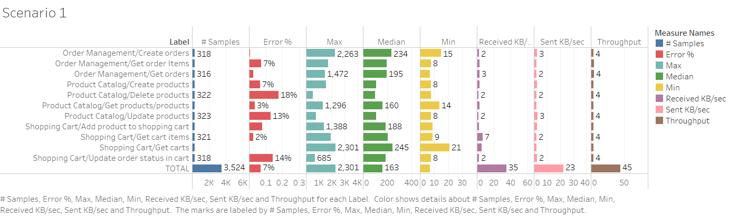
Results: Scenario 1

Slide 9
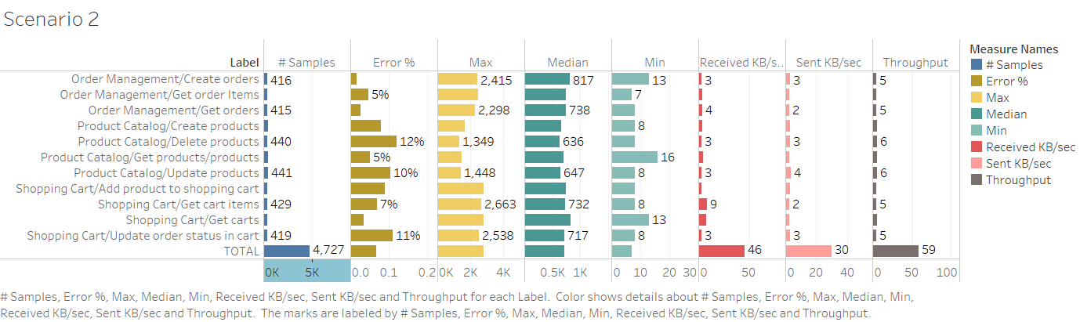
Results: Scenario 2

Slide 10
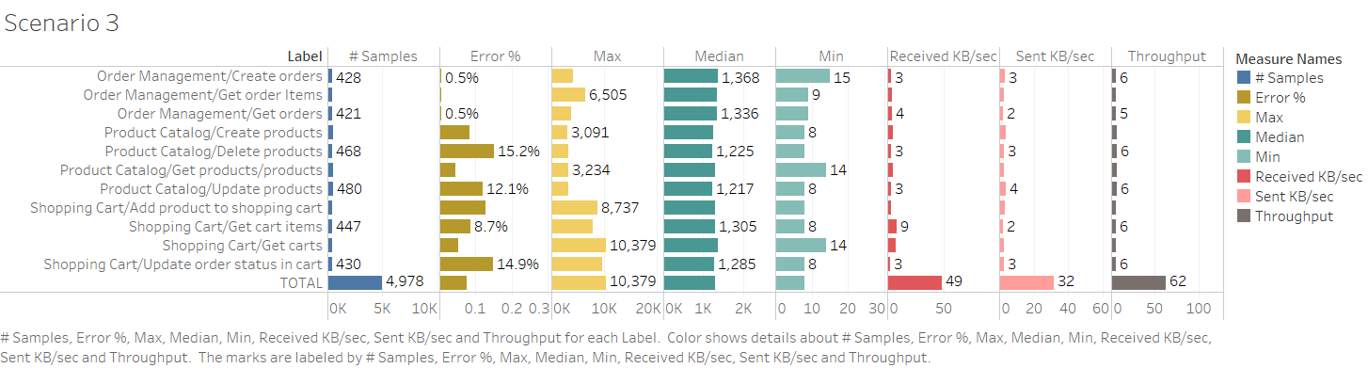
Results: Scenario 3

Slide 11
Conclusion
Conclusion will be derived based on the results

Slide 12
Future Work

